Slide 1

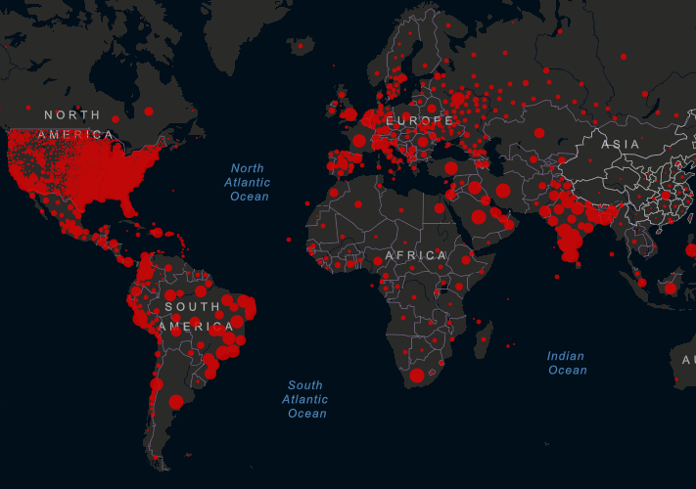
ADS, block 3 Spatial statistics and machine learning
Dr. Menno Straatsma, coordinator Fac. Geosciences, dept. Physical Geography m.w.Straatsma@uu.nl
Dr. Anae Sobhani,
Fac. Geosciences, dept. Human Geography and spatal planning
https://coronavirus.jhu.edu/map.html

Slide 2
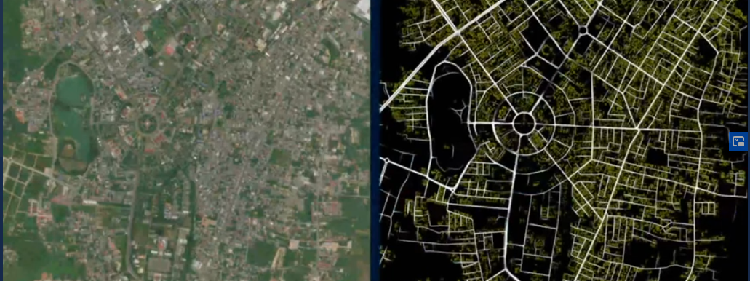
Example road mapping for OpenStreetMap
https://www.youtube.com/watch?time_continue=150&v=E7xa7C5MugA&feature=emb_title

Slide 3
Components of the course
Spatial data wrangling and visualization
Point pattern analysis, including GPS tracks
Spatial statistics and interpolation techniques
Remote sensing
Spectral and lidar data
Preprocessing and classification
Machine learning
Scalebility of the processing pipeline:
Google Earth Engine
your own code
Final project

Slide 4
Final project
In multidisciplinary teams
Topics from physical geography, human geography, social science, environmental epidemiology
Report in a paper and online documentation, e.g. github or ArcGIS-online

Slide 5
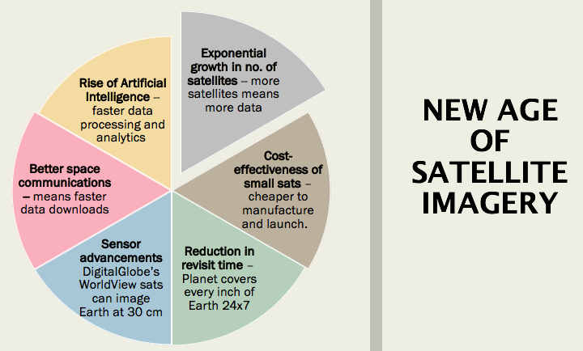
Interesting times in geodata science
https://www.geospatialworld.net/blogs/key-trends-in-earth-observation/

